Slide 1
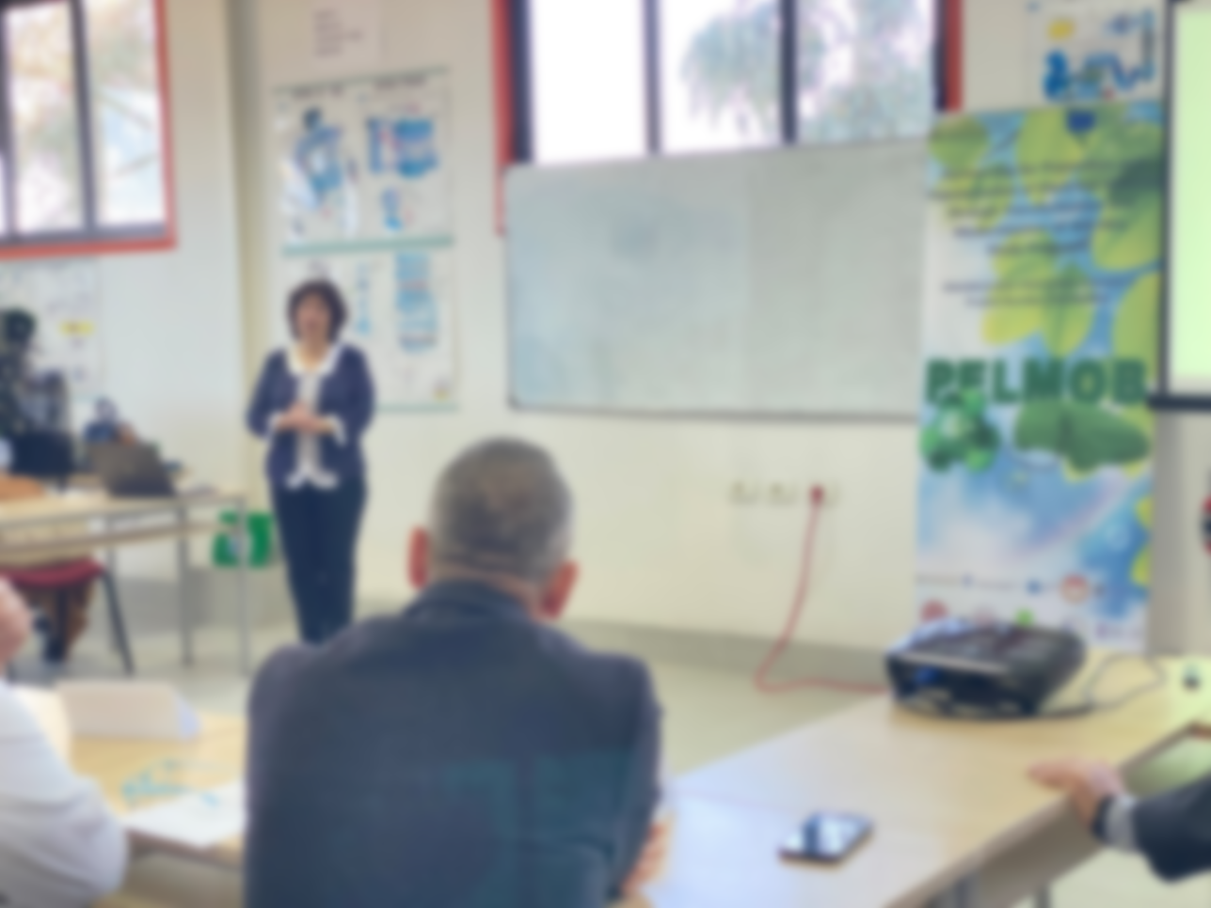
WORKSHOP FOR PROMOTION AND POPULARIZATION OF ELECTRICAL MOBILITY
in the framework of the Project PELMOB “Promotion and Popularization of Electrical Mobility through Transformation and Modernization of WB HEIs Study Programs”
Call: ERASMUS-EDU-2022-CBHE-STRAND-2
Project Number: 101082860

Slide 2
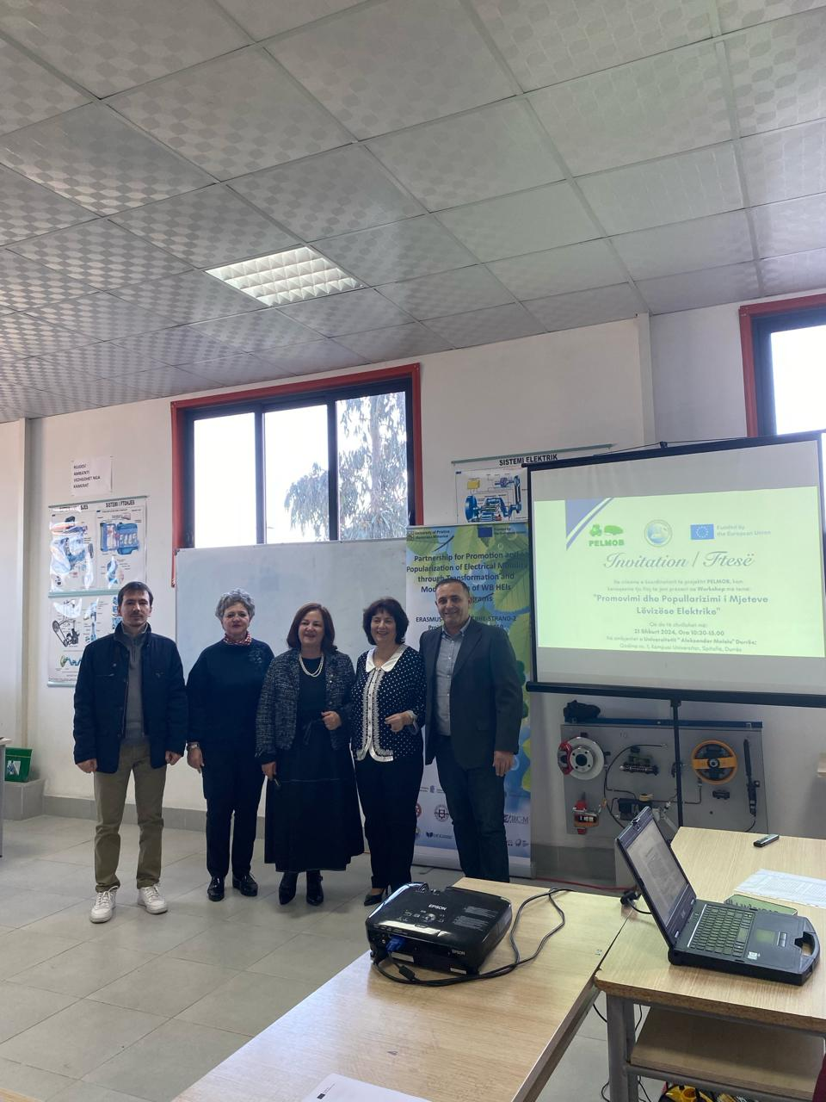
LOCAL WORKSHOP
”NETWORKING WITH INTERESTED PARTIES AND CITIZENS OF ELECTRICAL MOBILITY IN THE COUNTRIES OF THE WESTERN BALKANS”
WP4, D4.2
https://uamd.edu.al/pelmob-promovimi-dhe-popullarizimi-i-levizsherive-elektrike/
Dr. Ing. Alma Golgota¹, Dr. Alma Stana², Ing. Erion Mali³, Phd.cand. Eduart Ndokaj⁴,
Prof. AS. Dr. Flora Merko⁵
¹Lecturer, Faculty of Professional Studies, Aleksandër Moisiu University, Durrës, Albania,
almagolgota@uamd.edu.al
²Lecturer, Faculty of Information Technology, Aleksandër Moisiu University, Durrës,Albania
alma.stana@uamd.edu.al
³Lecturer, Faculty of Professional Studies Aleksandër Moisiu University, Durrës,Albania,
erionmali@uamd.edu.al
⁴Lecturer, Faculty of Professional Studies, Aleksandër Moisiu University, Durrës, Albania,
eduartndokaj@uamd.edu.al
⁵Lecturer, Business Faculty, Aleksandër Moisiu University, Durrës, Albania,
floramerko@uamd.edu.al
Date | 21.02.2024
City | Durrës, Albania
Place | Lab of Automotive Technology, Faculty of Professional Studies
Adress | University “Aleksander Moisiu”, Durrës, Albania – UAMD, University Campus, Spitallë, Durrës, Albania

Slide 3
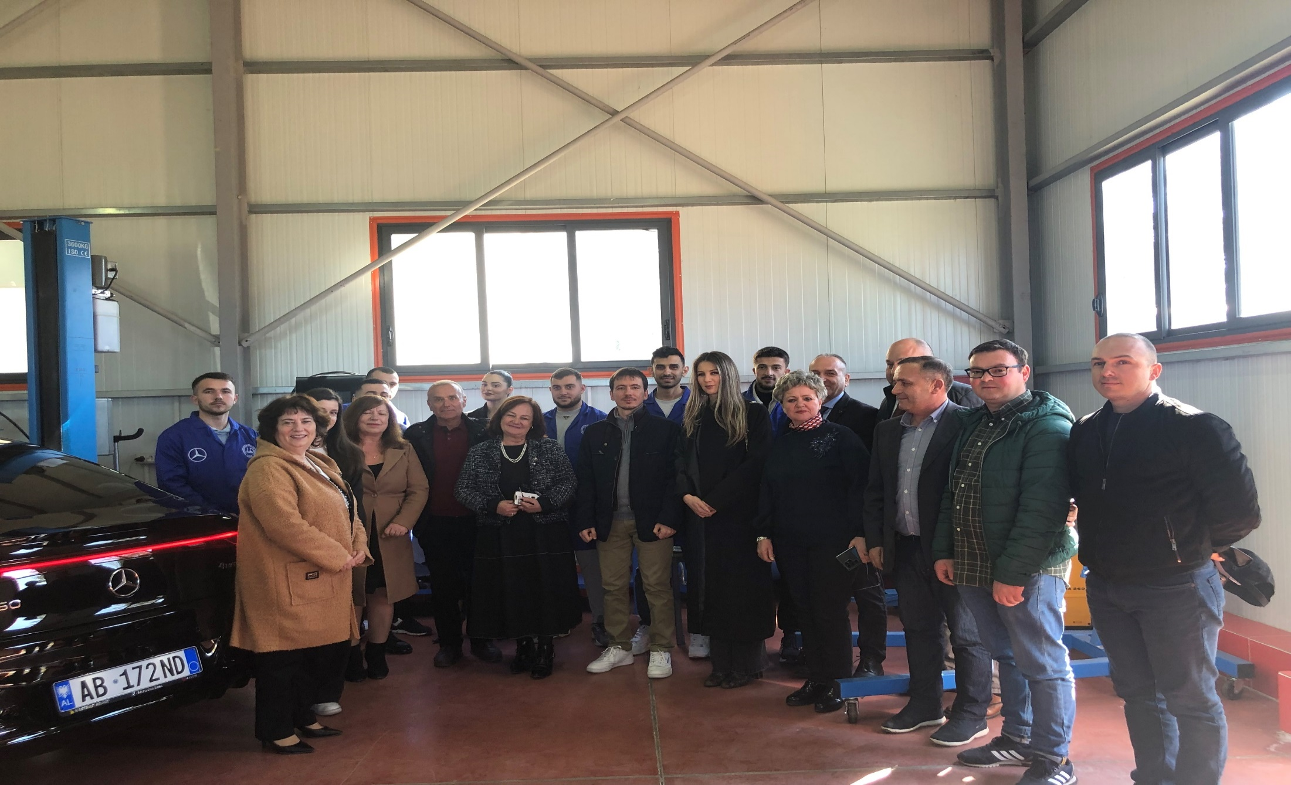

Slide 4
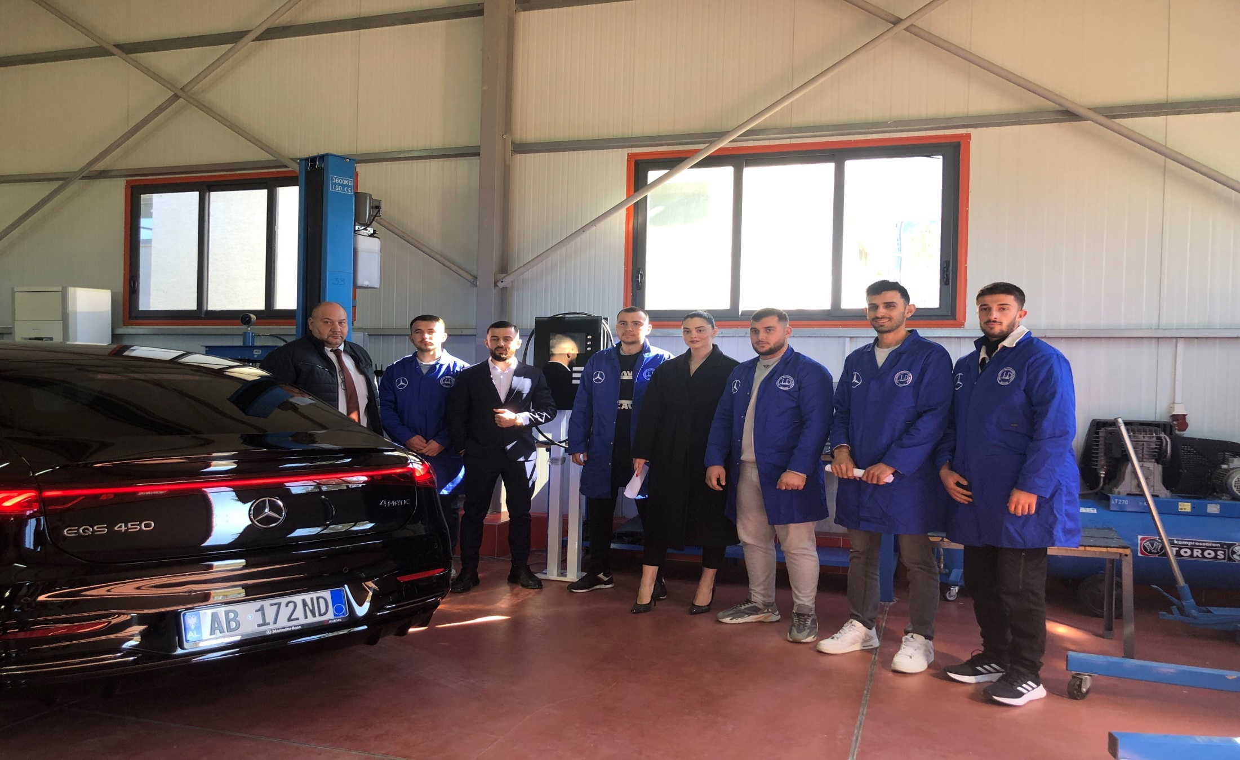

Slide 5
LOCAL WORKSHOP ”NETWORKING WITH INTERESTED PARTIES AND CITIZENS OF ELECTRICAL MOBILITY IN THE COUNTRIES OF THE WESTERN BALKANS” FIRST SESSION
Wednesday 21 Shkurt 2024
University “Aleksander Moisiu”, Durrës, Albania – UAMD – Faculty of Professionals Studies
10:00-10:30 | Registration of participants
Session I – The opening of the event
10:30-11:30 | The Word of Welcome: Prof. Dr. Osman Metalla, Dean of Faculty of Professionals Studies, Universitety “Aleksandër Moisiu” Durrës. Eng. Mimoza Dyrmyshi, Representative of Municipality Durrës.

Slide 6
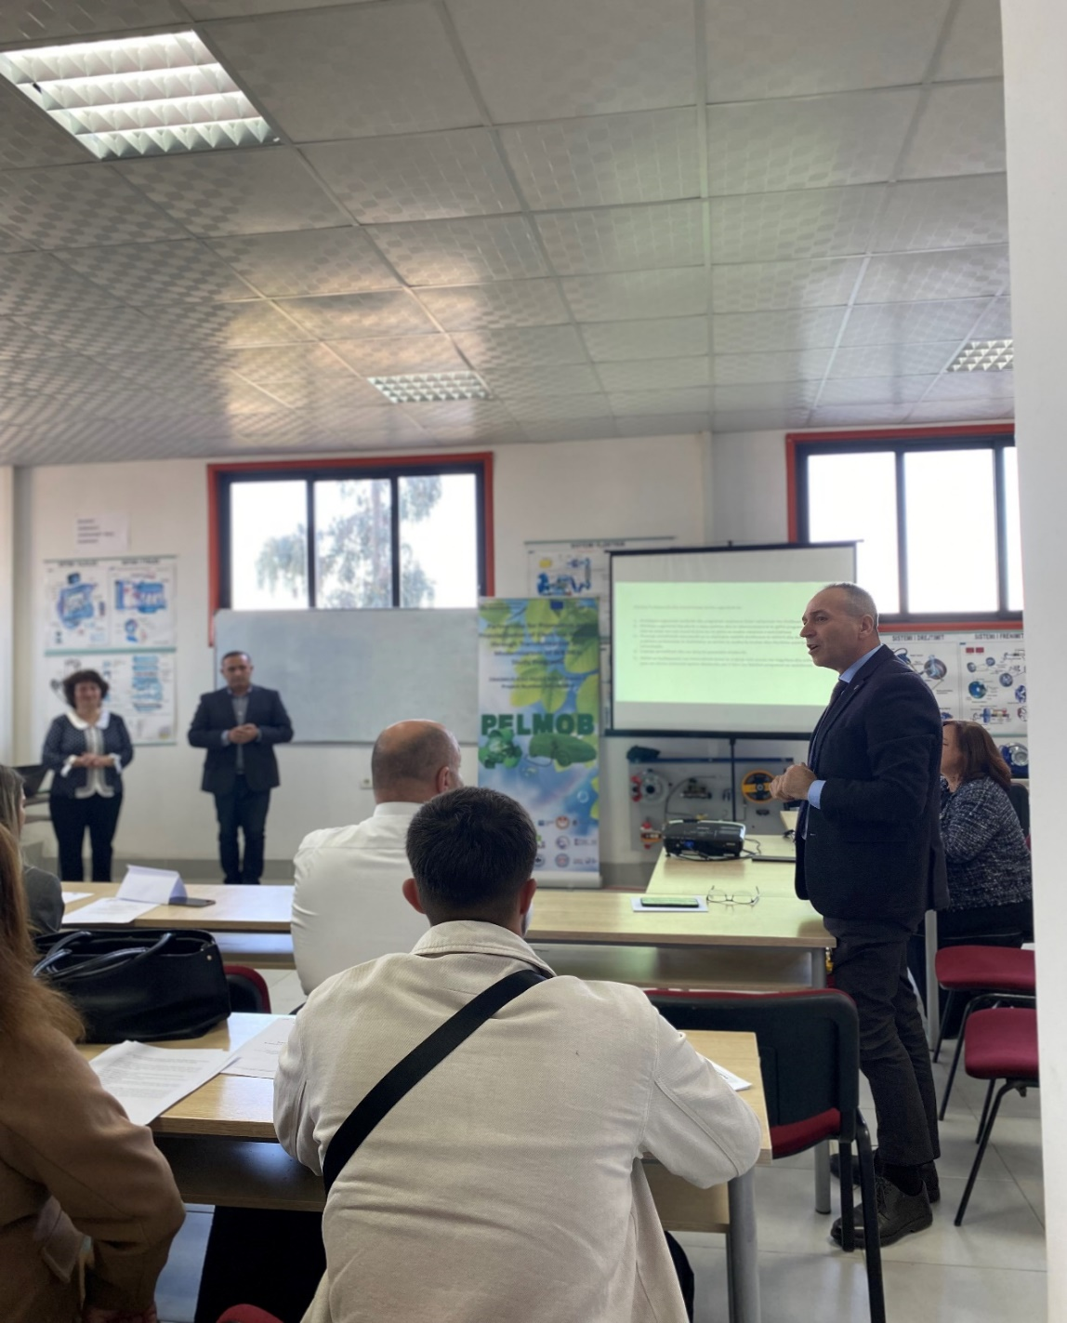
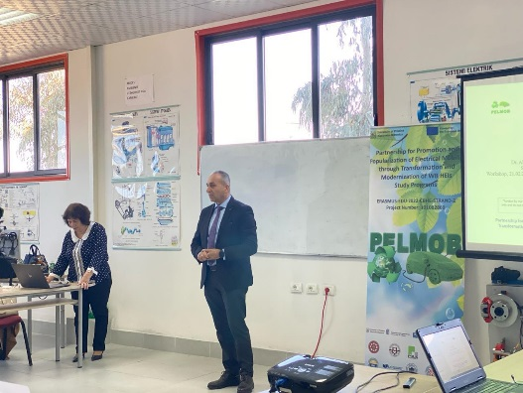
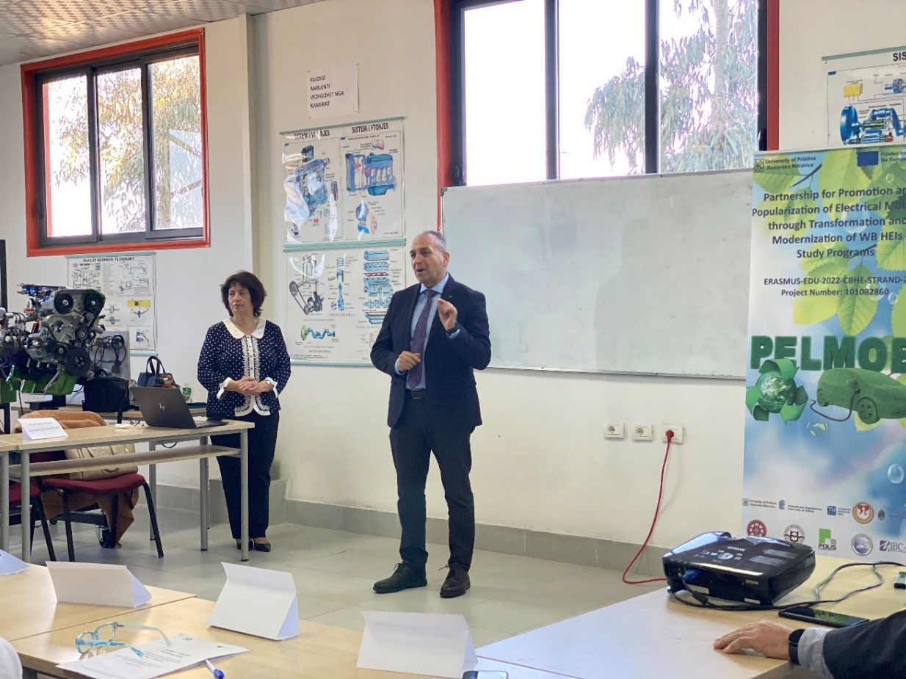
Session I The opening of the event

Slide 7
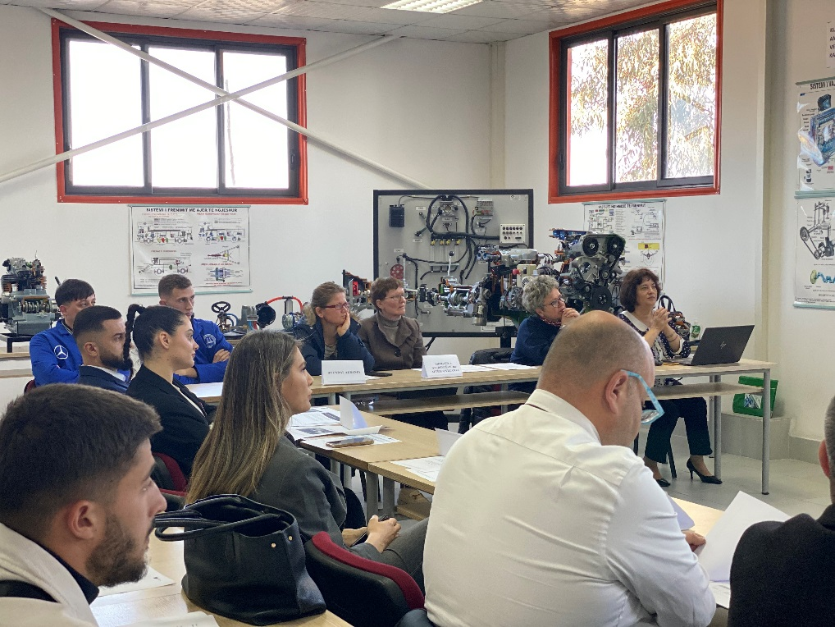
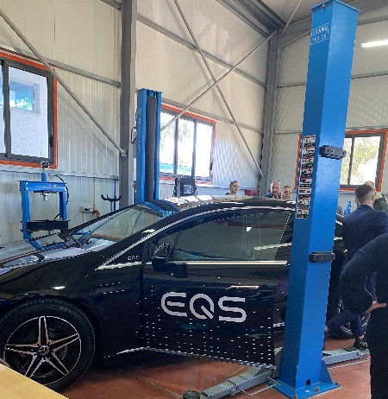
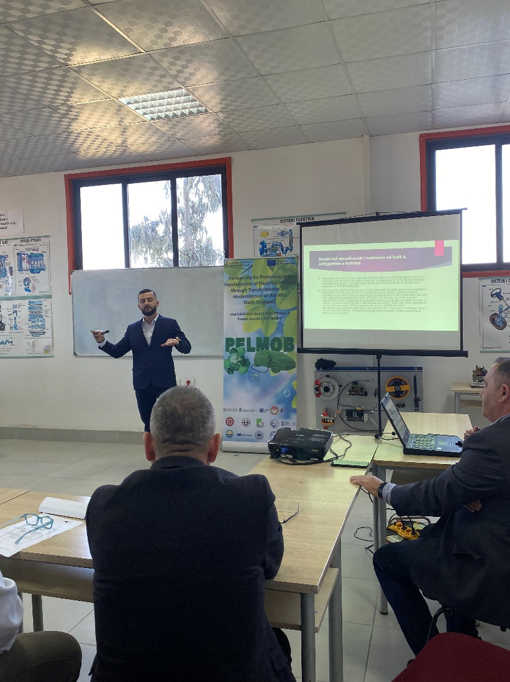
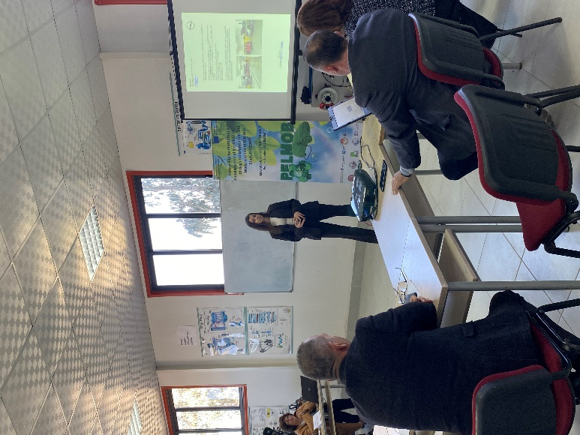

Slide 8
LOCAL WORKSHOP ”NETWORKING WITH INTERESTED PARTIES AND CITIZENS OF ELECTRICAL MOBILITY IN THE COUNTRIES OF THE WESTERN BALKANS” Second SESSION
Second Session: The presentations of the Project PELMOB
11:30-12:00 | Project PELMOB; The Objectives and the Impact | Dr. Ing. Alma Golgota, Cordinator of the project PELMOB Faculty of Professional Studies, Aleksandër Moisiu University, Durrës, Albania
12:00-12:30 | The Future of Automotive Transport for Electric Mobility in Albania | PhD. Cand. Eduart Ndokaj, Faculty of Professional Studies, Aleksandër Moisiu University, Durrës, Albania
12:30-13:00 | The Challenges of Electric Mobility in Albania | PhD. Cand Erion Mali, Faculty of Professional Studies, Aleksandër Moisiu University, Durrës, Albania
13:00-13:30 | The further Integration of Electric Vehicles as a fundamental step in achieving a more sustainable and environmentally friendly Transport System | Msc. Eng. Luiza Lluri, Loesto Qose (student TA) Faculty of Professional Studies, Aleksandër Moisiu University, Durrës, Albania
13:30- 14:00 | Coffee Break

Slide 9
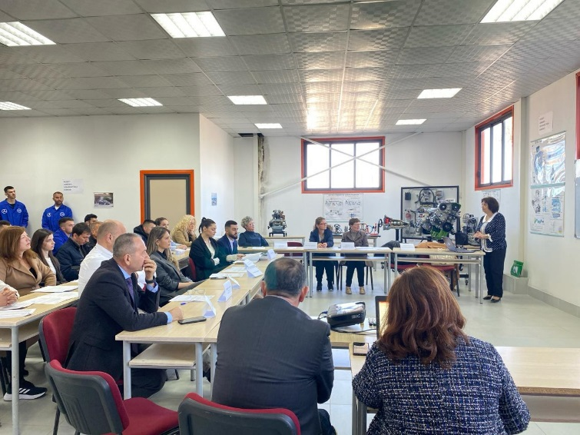
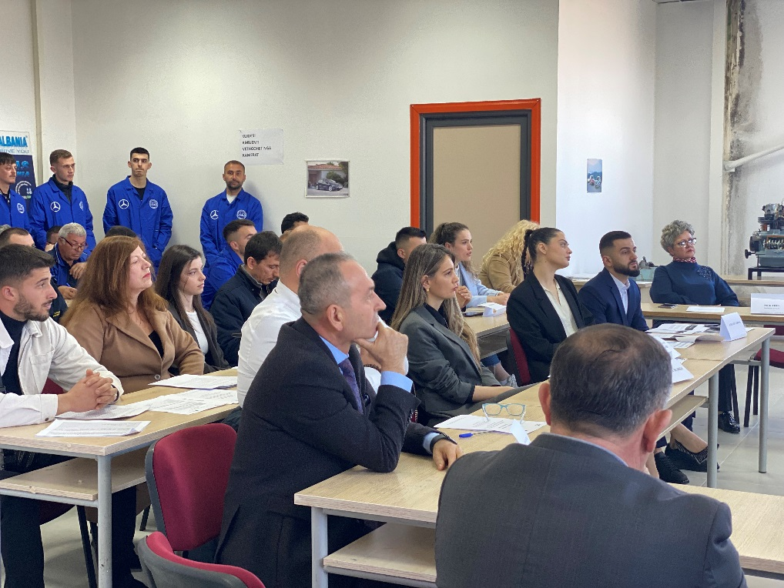
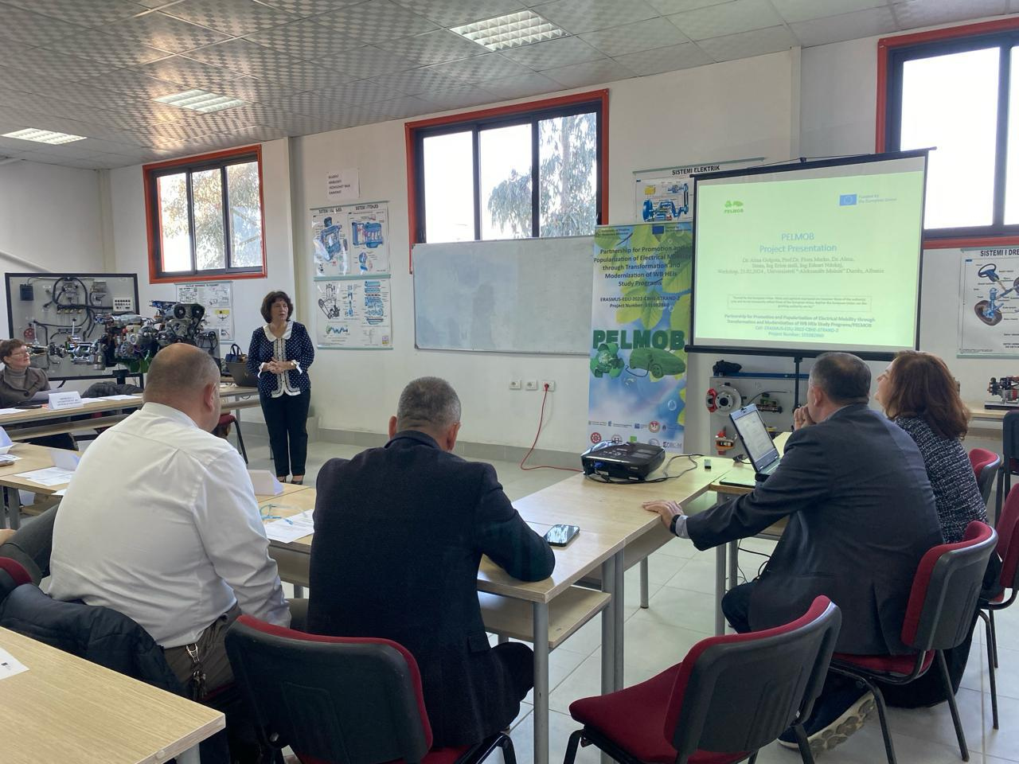
Project PELMOB; The Objectives and the Impact Dr. Ing. Alma Golgota, Cordinator of the project PELMOB Faculty of Professional Studies, Aleksandër Moisiu University, Durrës, Albania

Slide 10
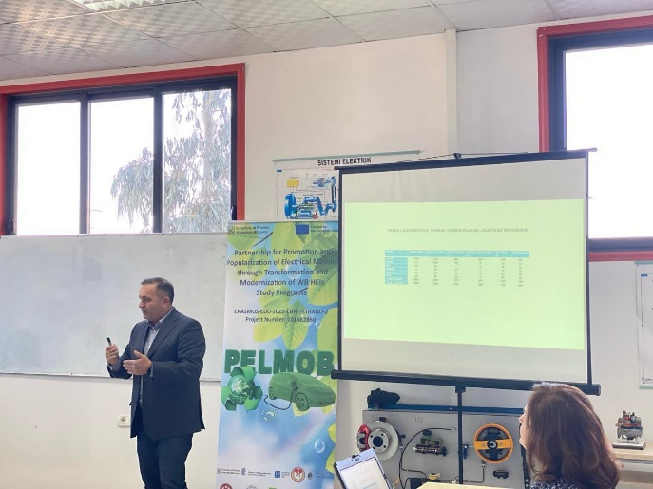
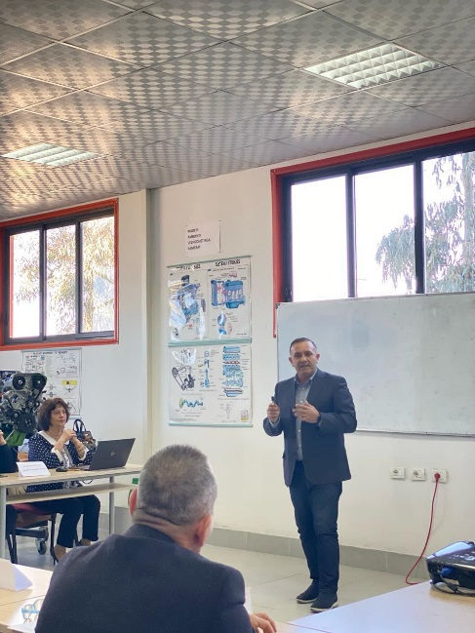
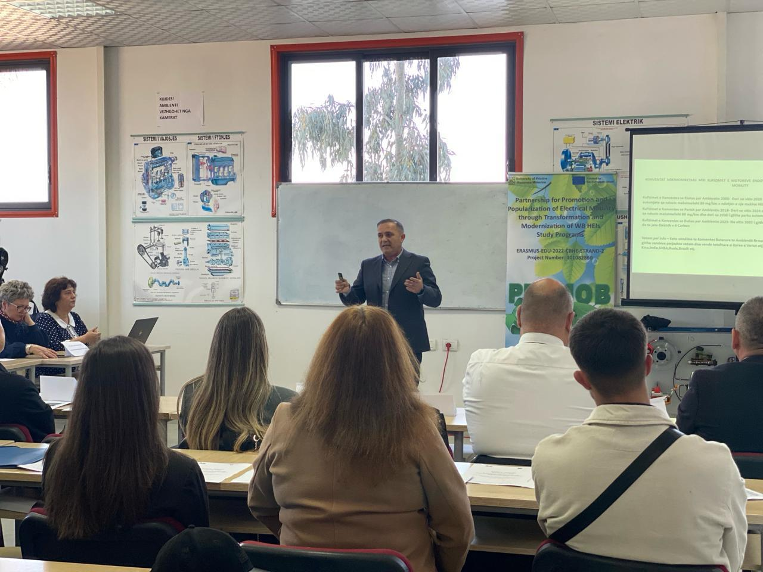
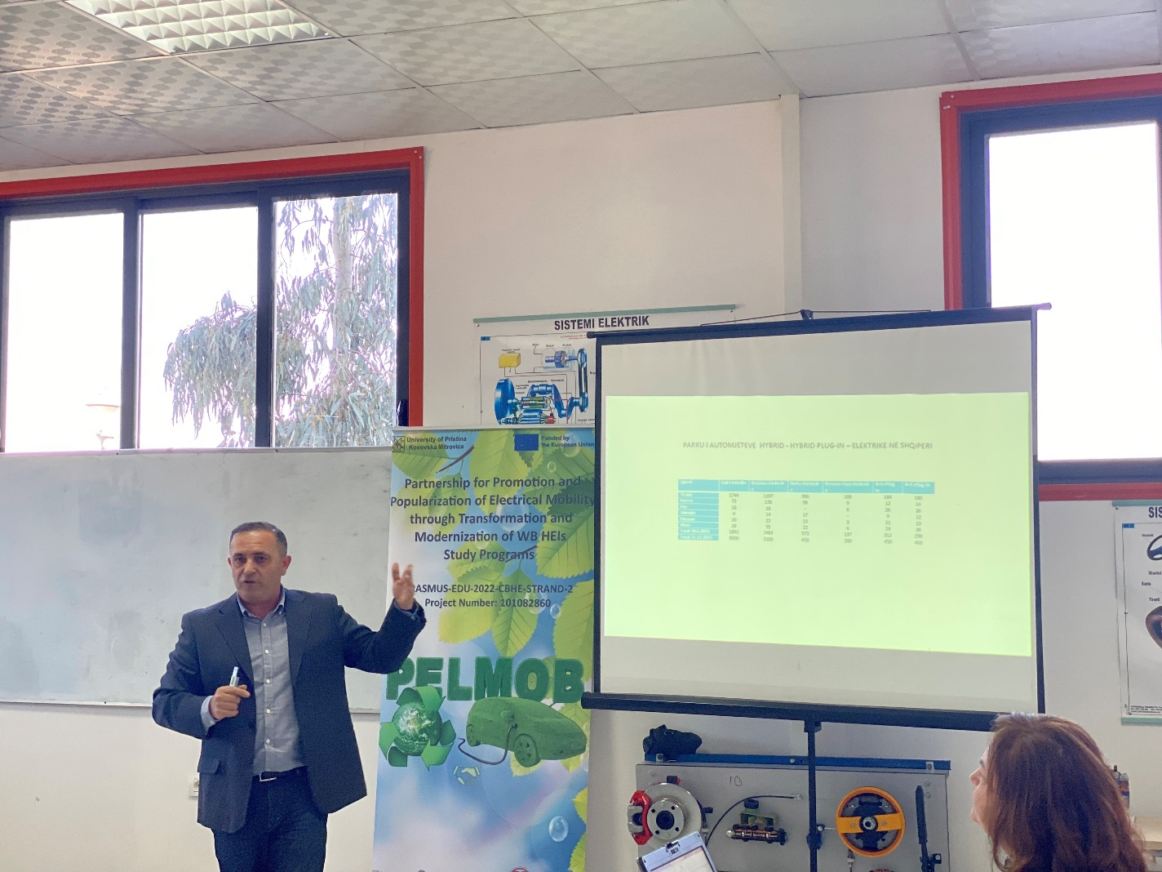
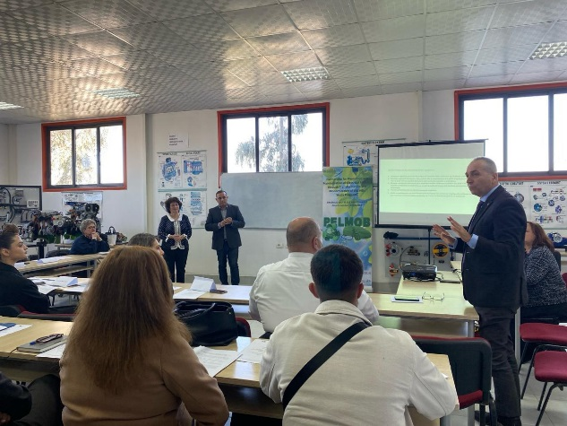
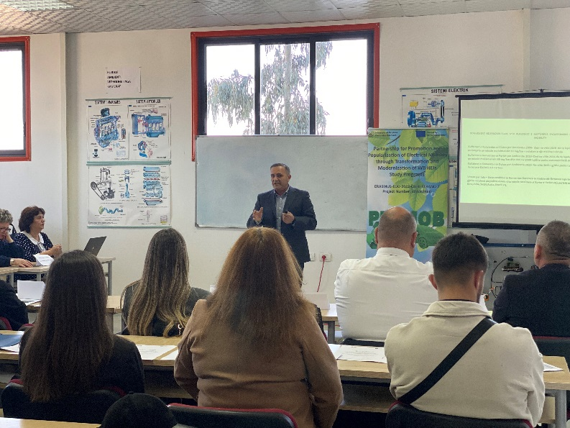
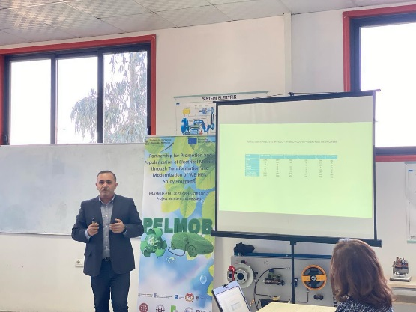
The Future of Automotive Transport for Electric Mobility in Albania PhD. Cand. Eduart Ndokaj, Faculty of Professional Studies, Aleksandër Moisiu University, Durrës, Albania

Slide 11
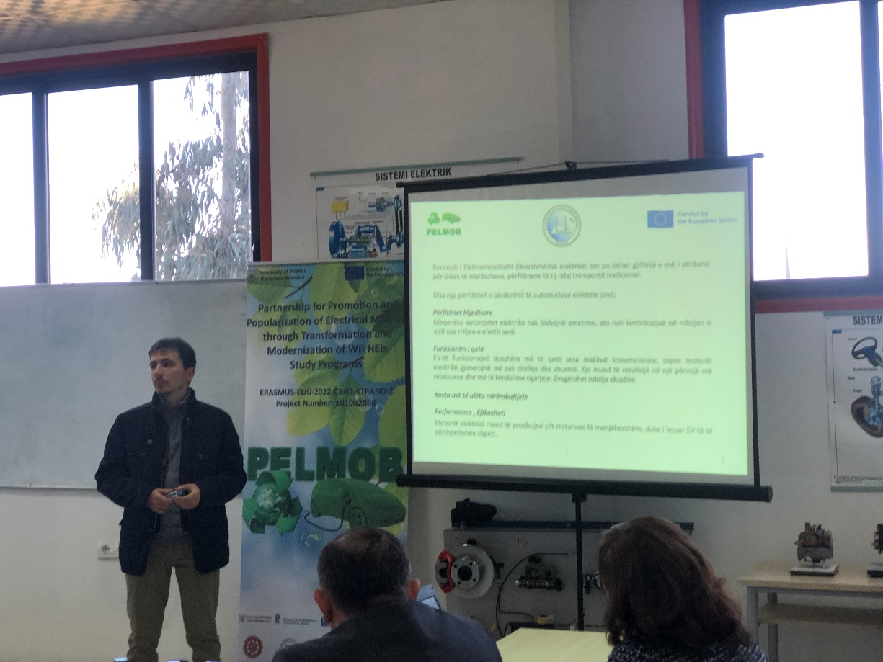
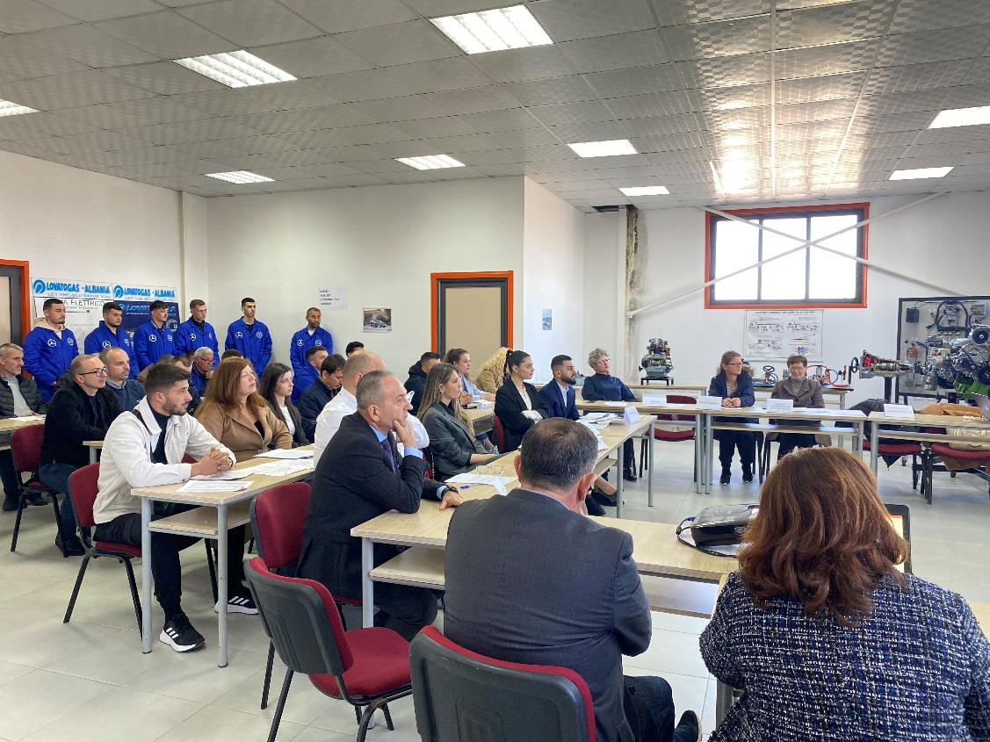
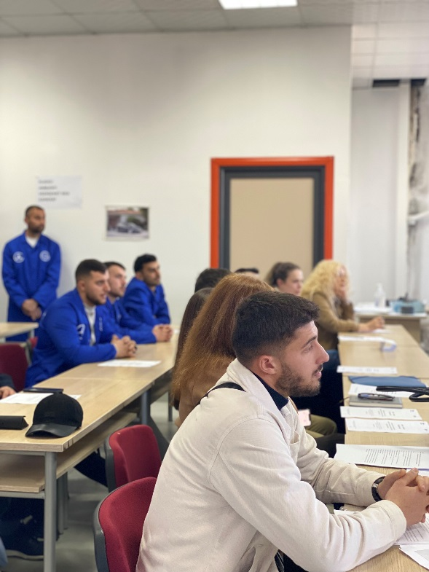
The Challenges of Electric Mobility in Albania PhD. Cand Erion Mali, Faculty of Professional Studies, Aleksandër Moisiu University, Durrës

Slide 12
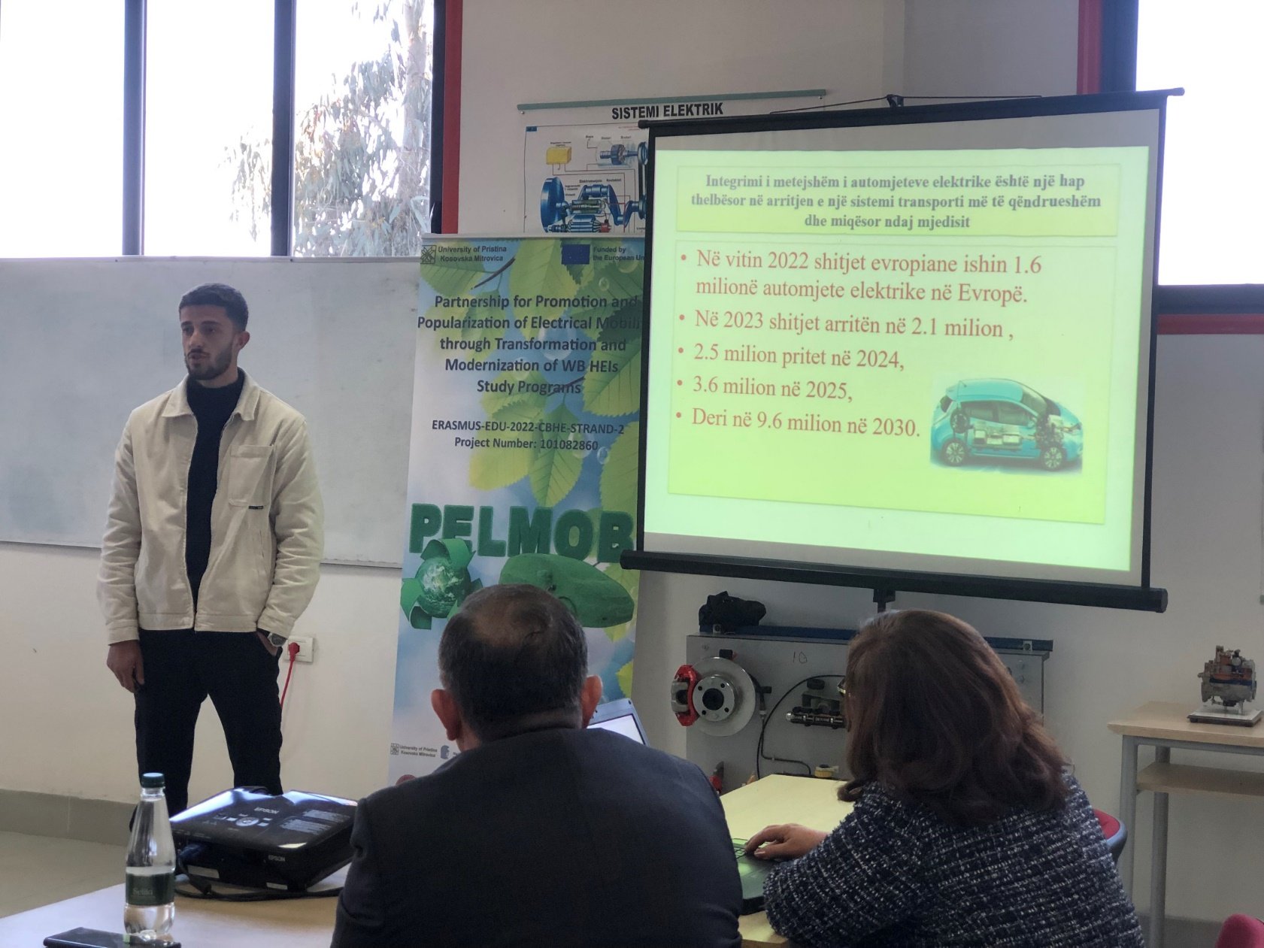
The further Integration of Electric Vehicles as a fundamental step in achieving a more sustainable and environmentally friendly Transport System Msc. Eng. Luiza Lluri, Loesto Qose (student TA) Faculty of Professional Studies

Slide 13
LOCAL WORKSHOP ”NETWORKING WITH INTERESTED PARTIES AND CITIZENS OF ELECTRICAL MOBILITY IN THE COUNTRIES OF THE WESTERN BALKANS” Third SESSION
Third Session: The presentations of stakeholders as interested parties
14:00-14:10 | “PERISO Albania” shpk
14:10-14:20 | AUTOEUROPA, shpk
14:20-14:30 | “TETRA” shpk
14:30-15:40 | Albanian Motor Company-Ford-Hyundai, shpk
14:50-15:20 | Discussions
15:20-15:35 | The Closing of the discussions A visit to Lab The Conclusions of the Workshop

Slide 14
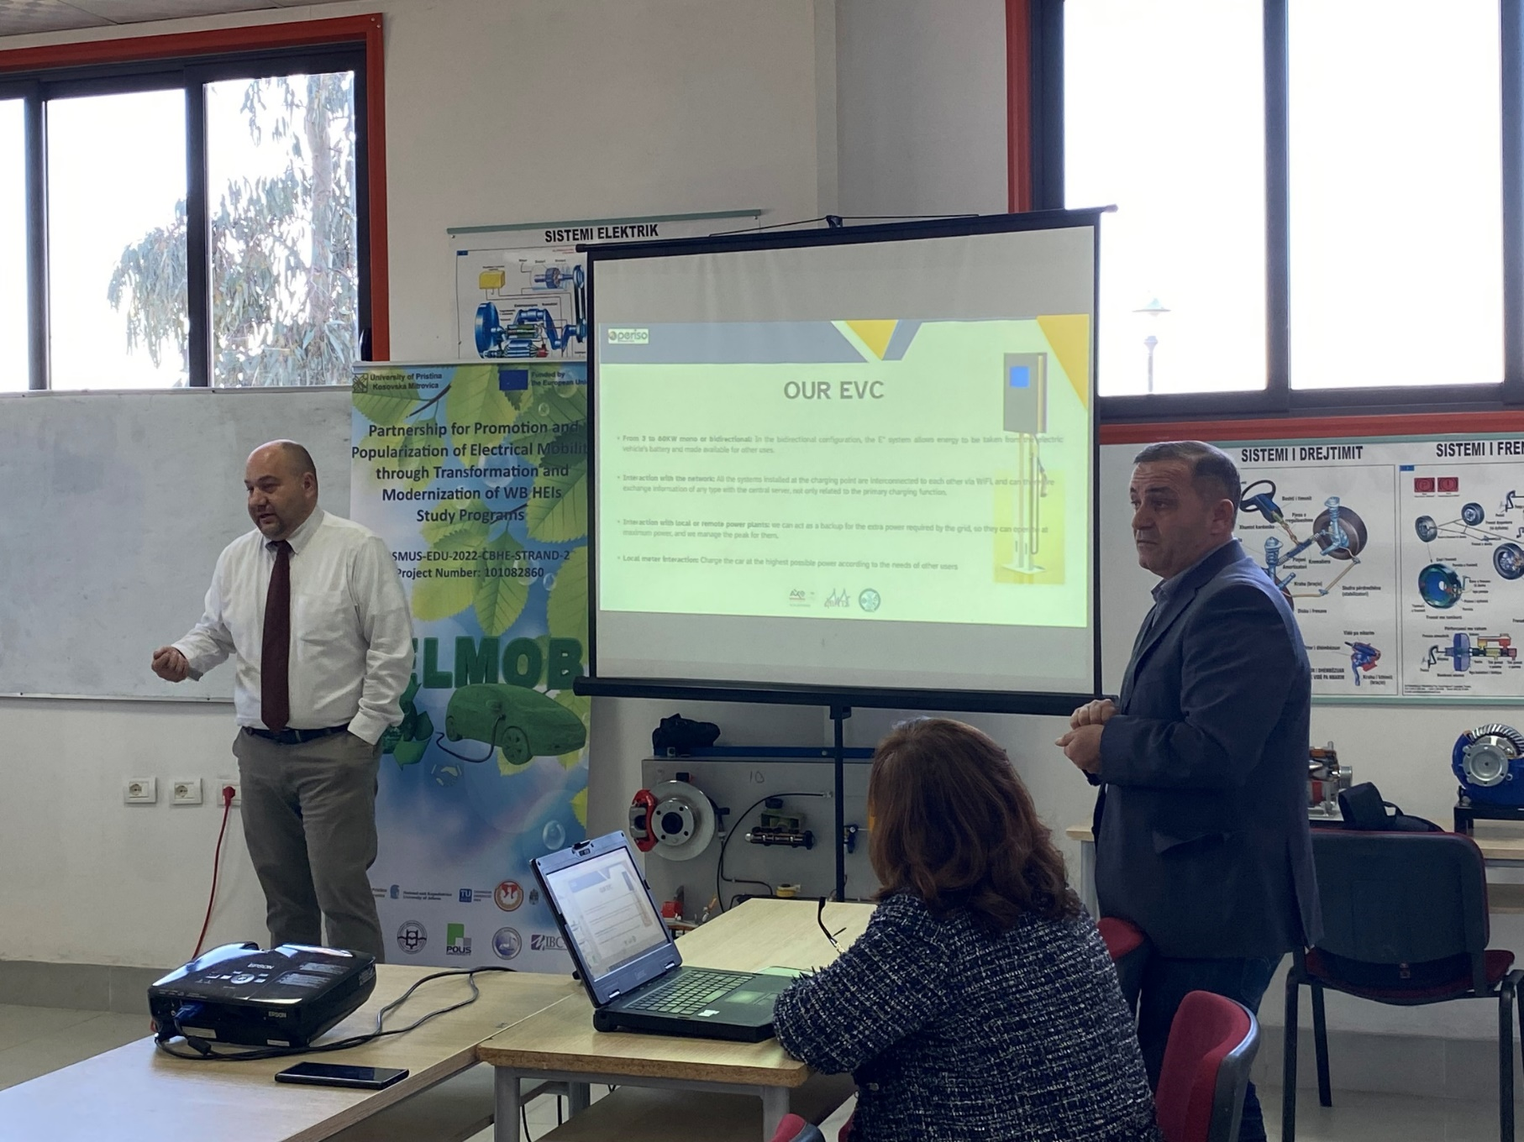
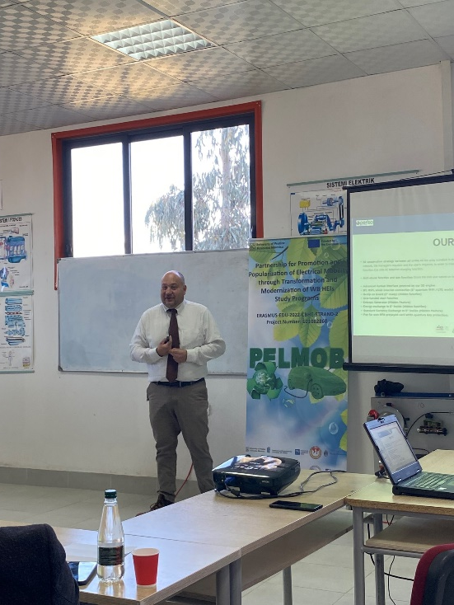
The presentations of stakeholders as interested parties “PERISO Albania”

Slide 15
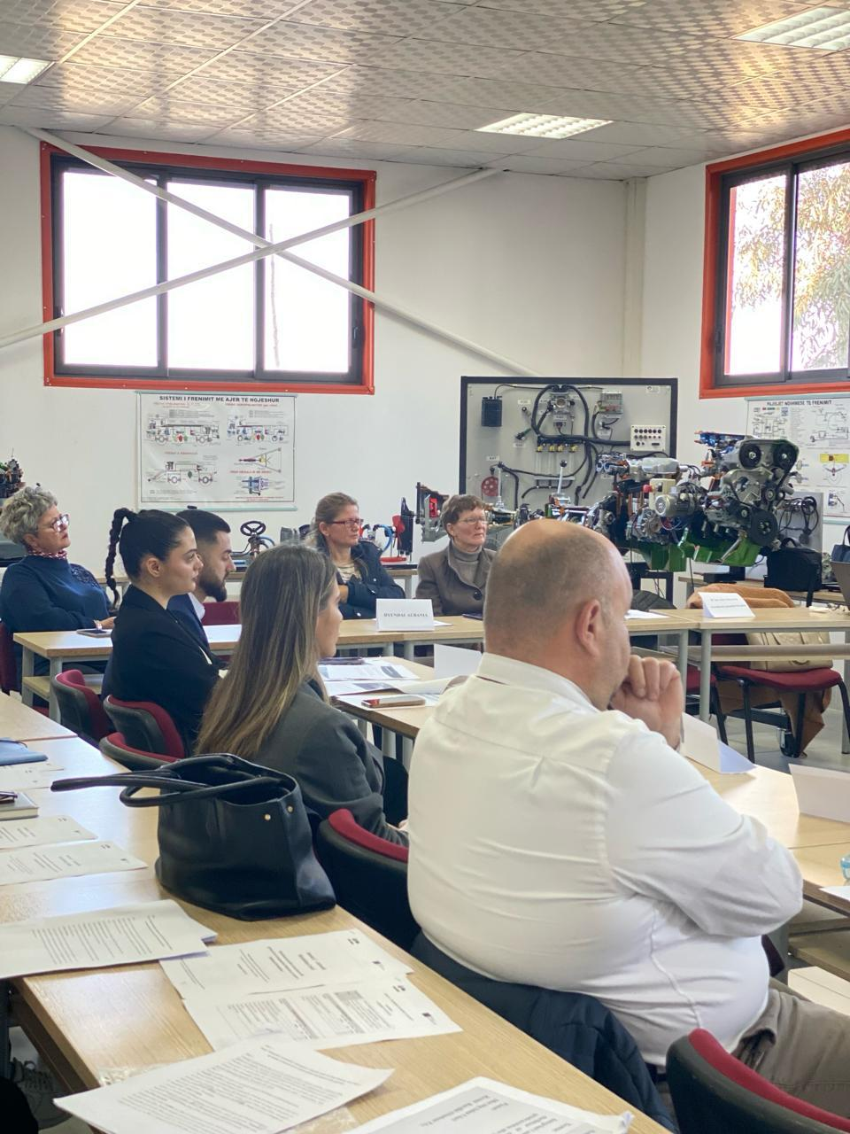
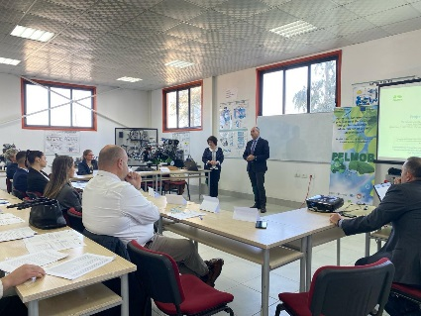
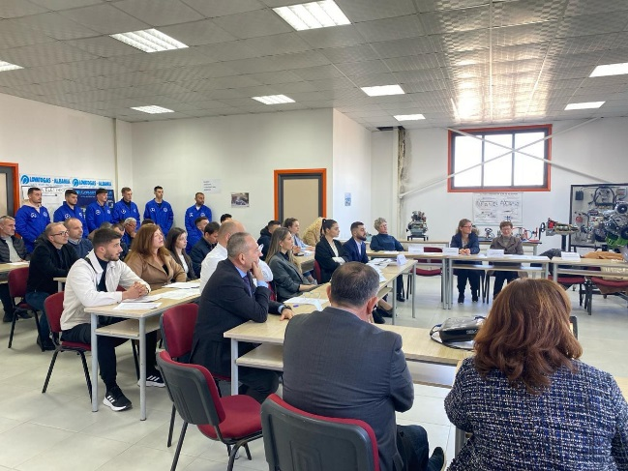
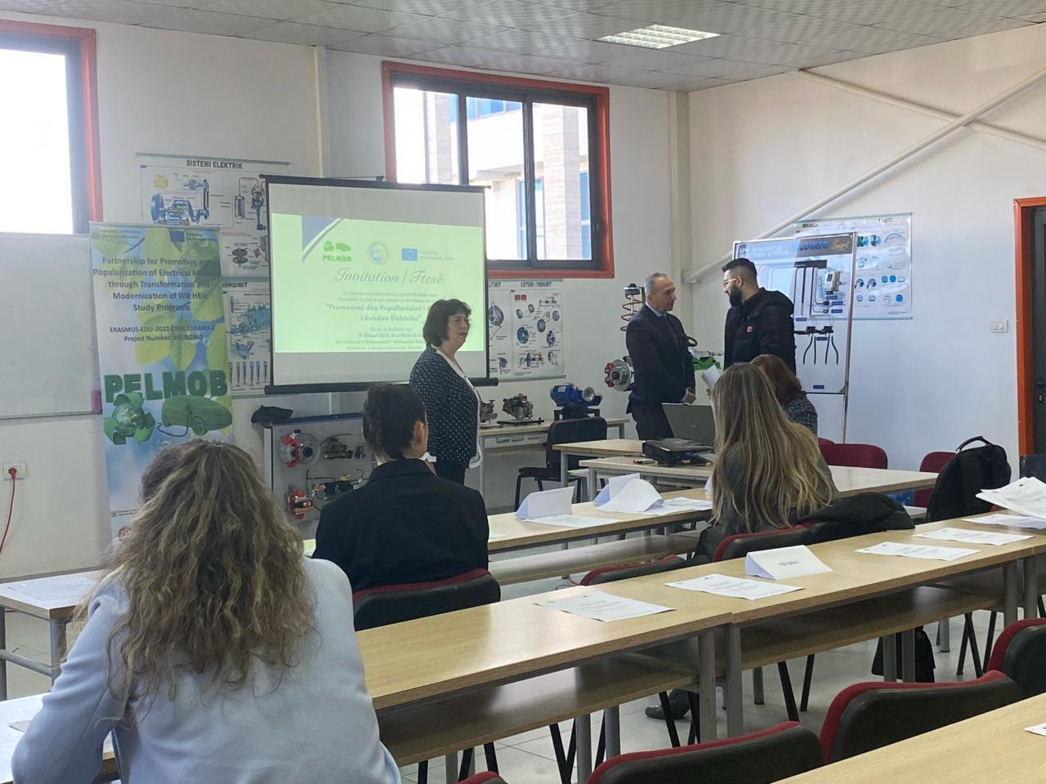
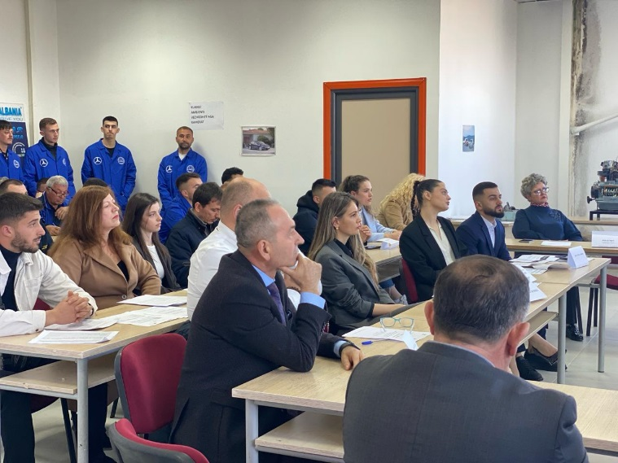
WORKSHOP

Slide 16
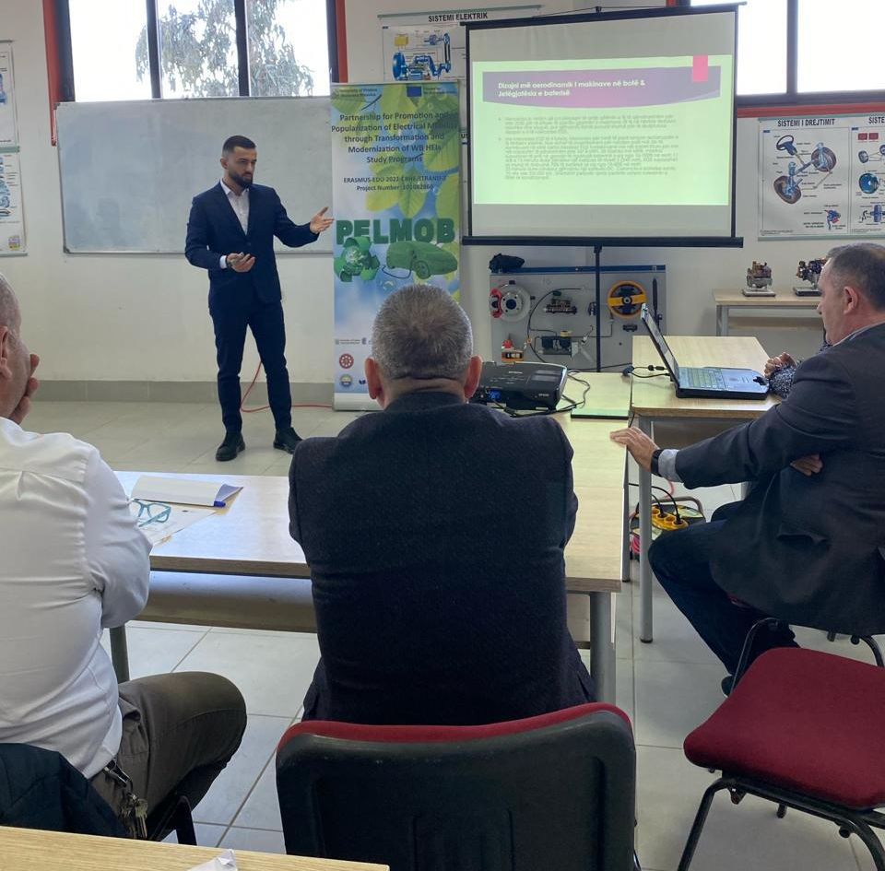
The presentations of stakeholders as interested parties
AUTOSTAR ALBANIA + ELECTRIC VEHICLE

Slide 17
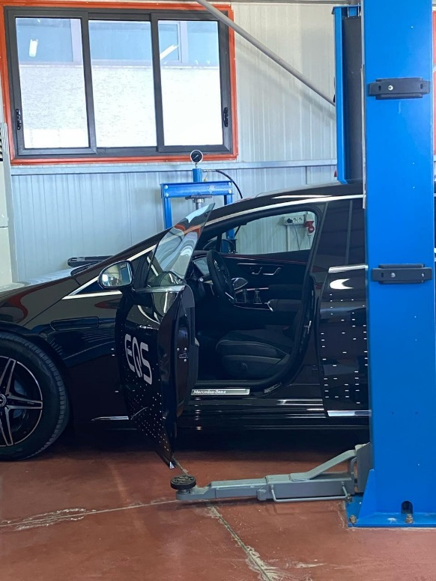
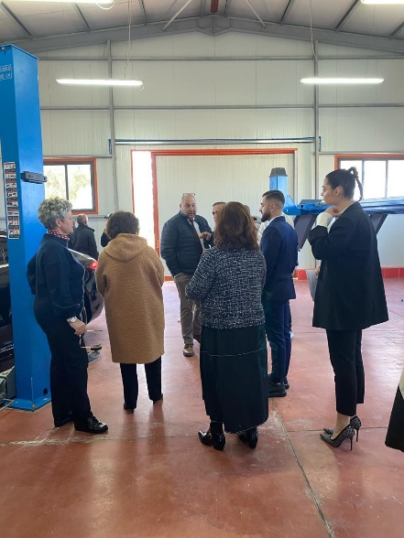
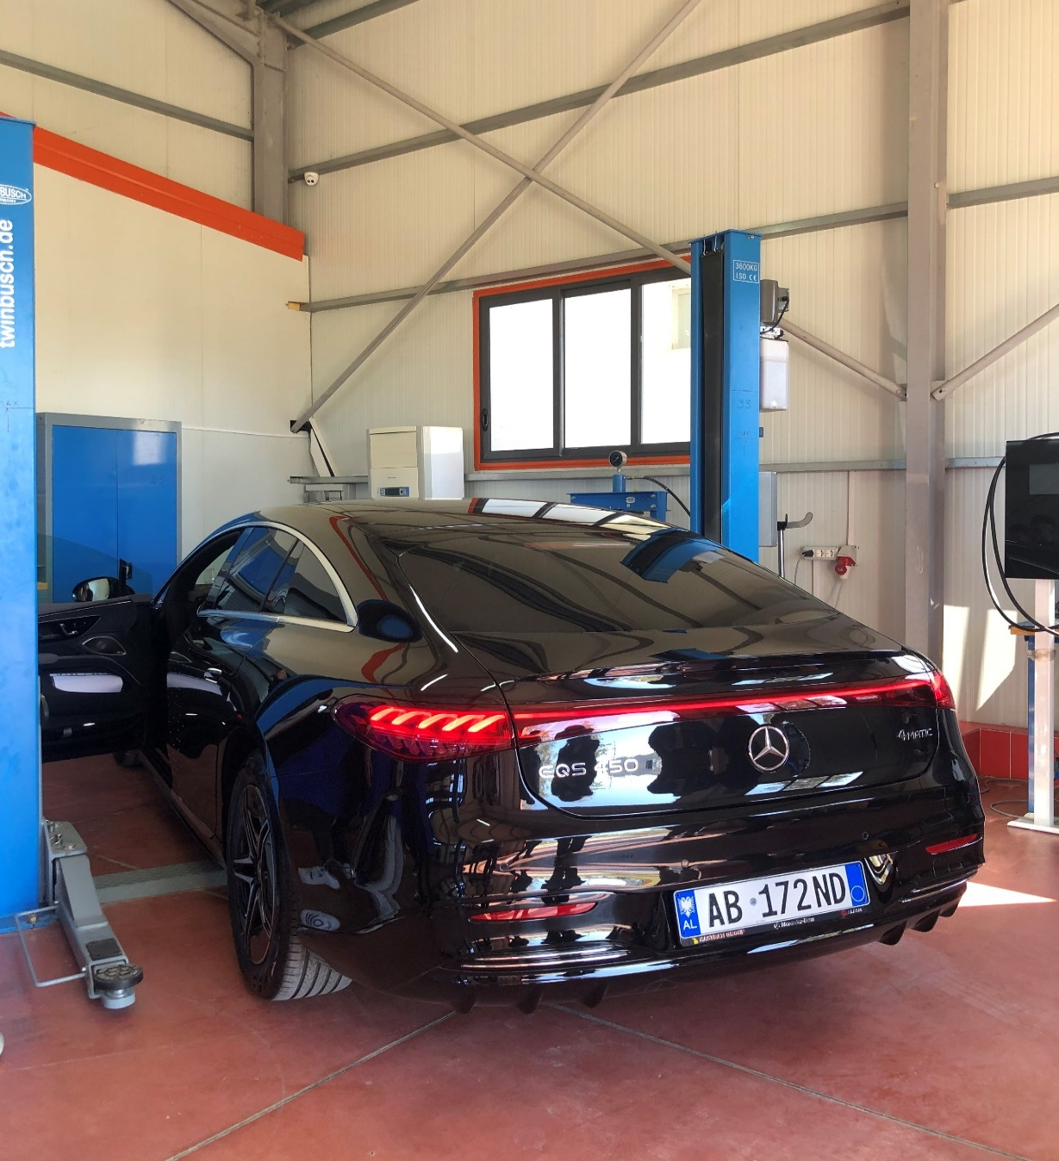
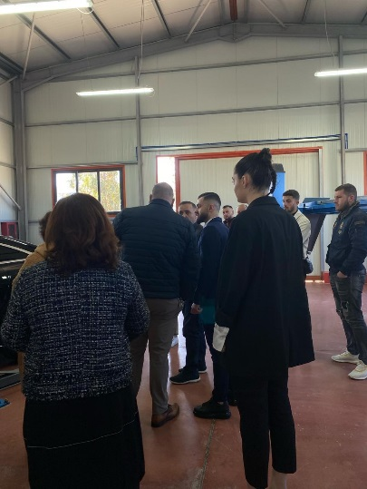
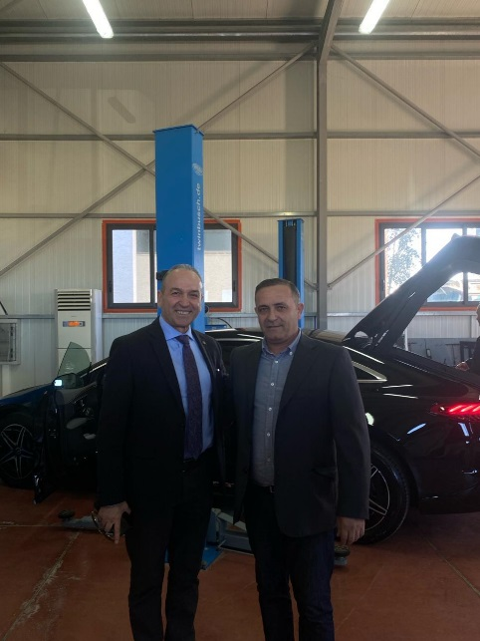
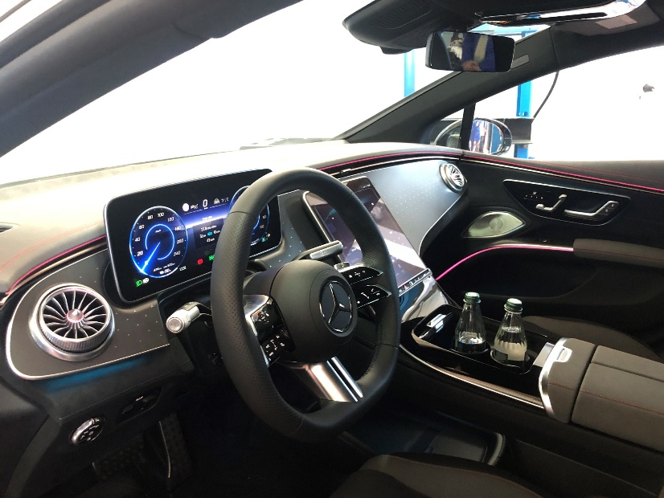

Slide 18
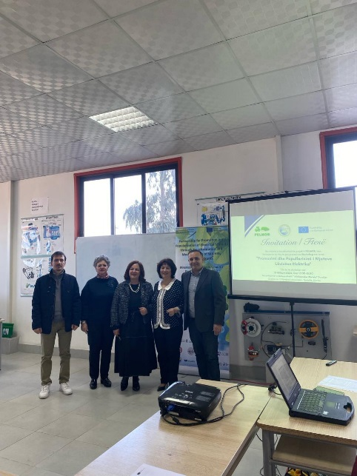
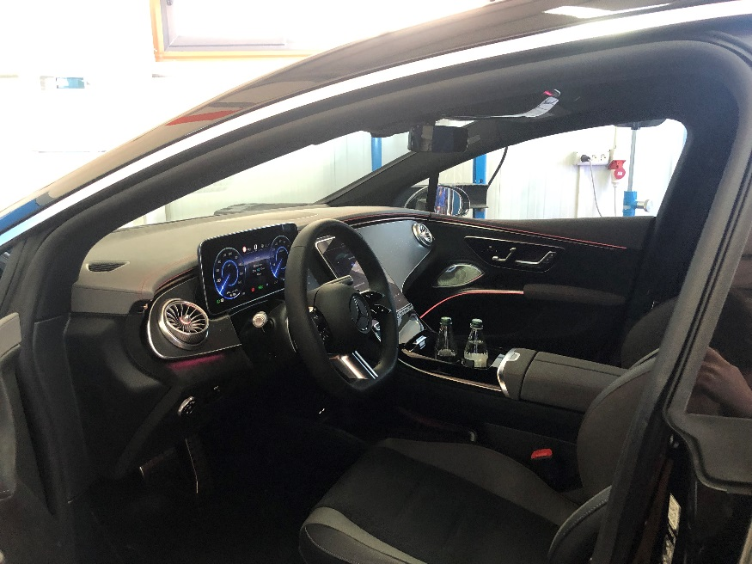
The presentations of stakeholders as interested parties
OPEL ALBANIA

Slide 19
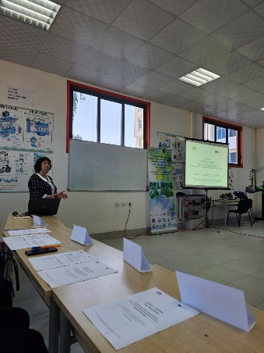
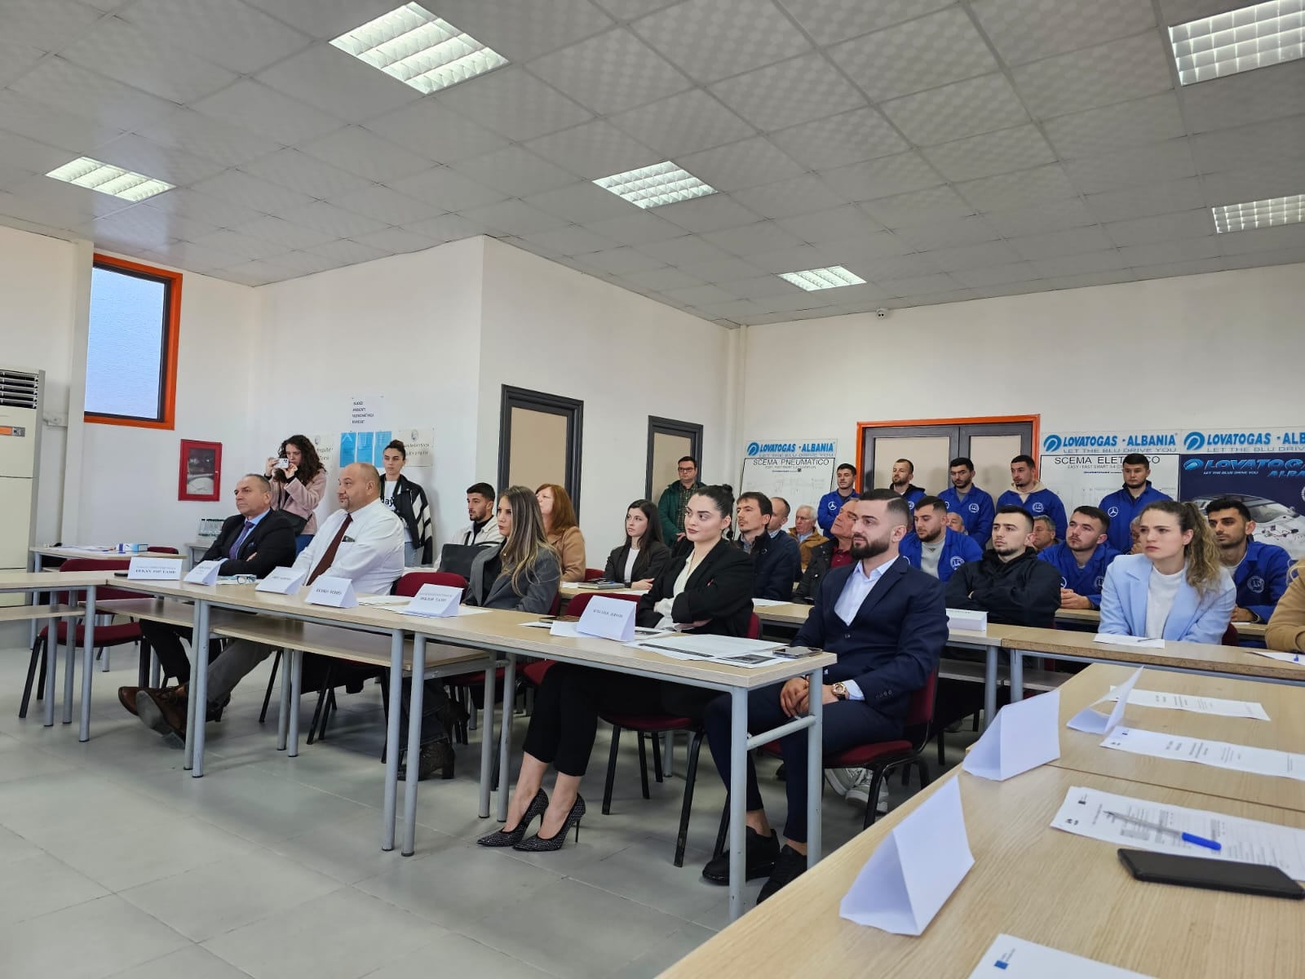
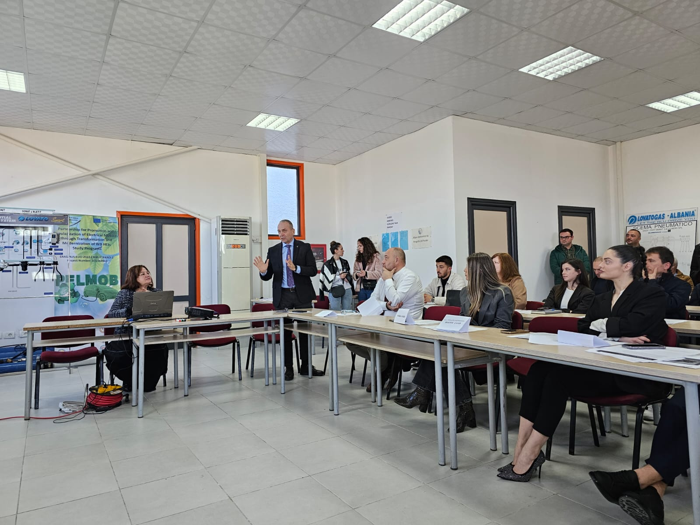
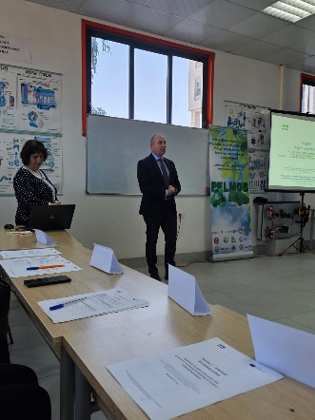
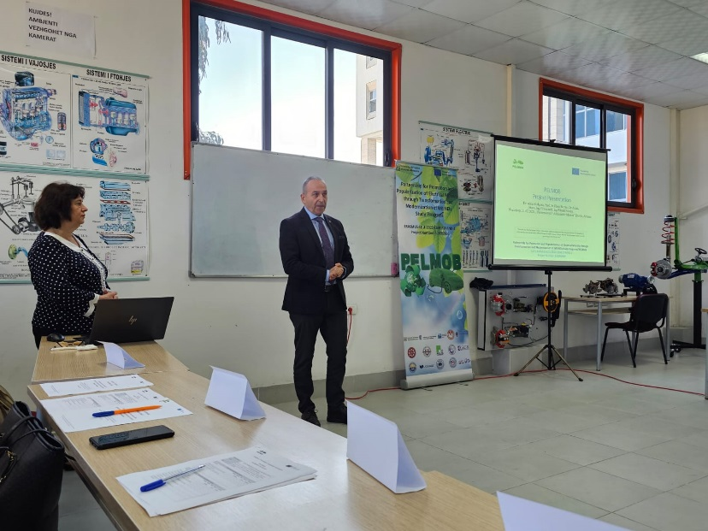
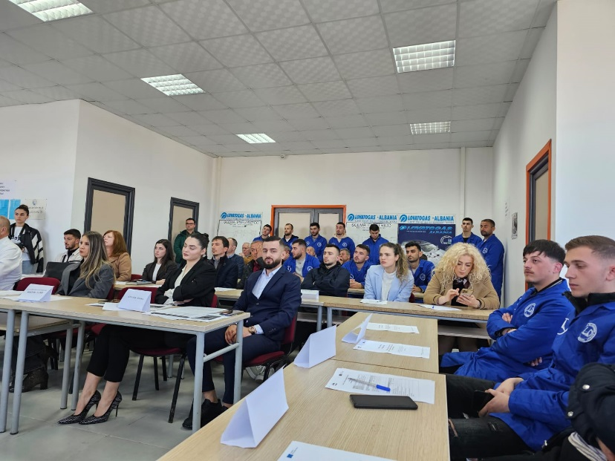
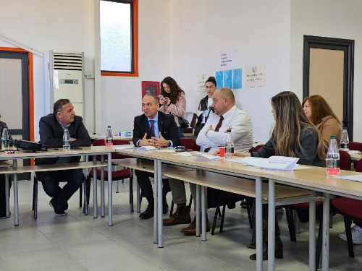

Slide 20
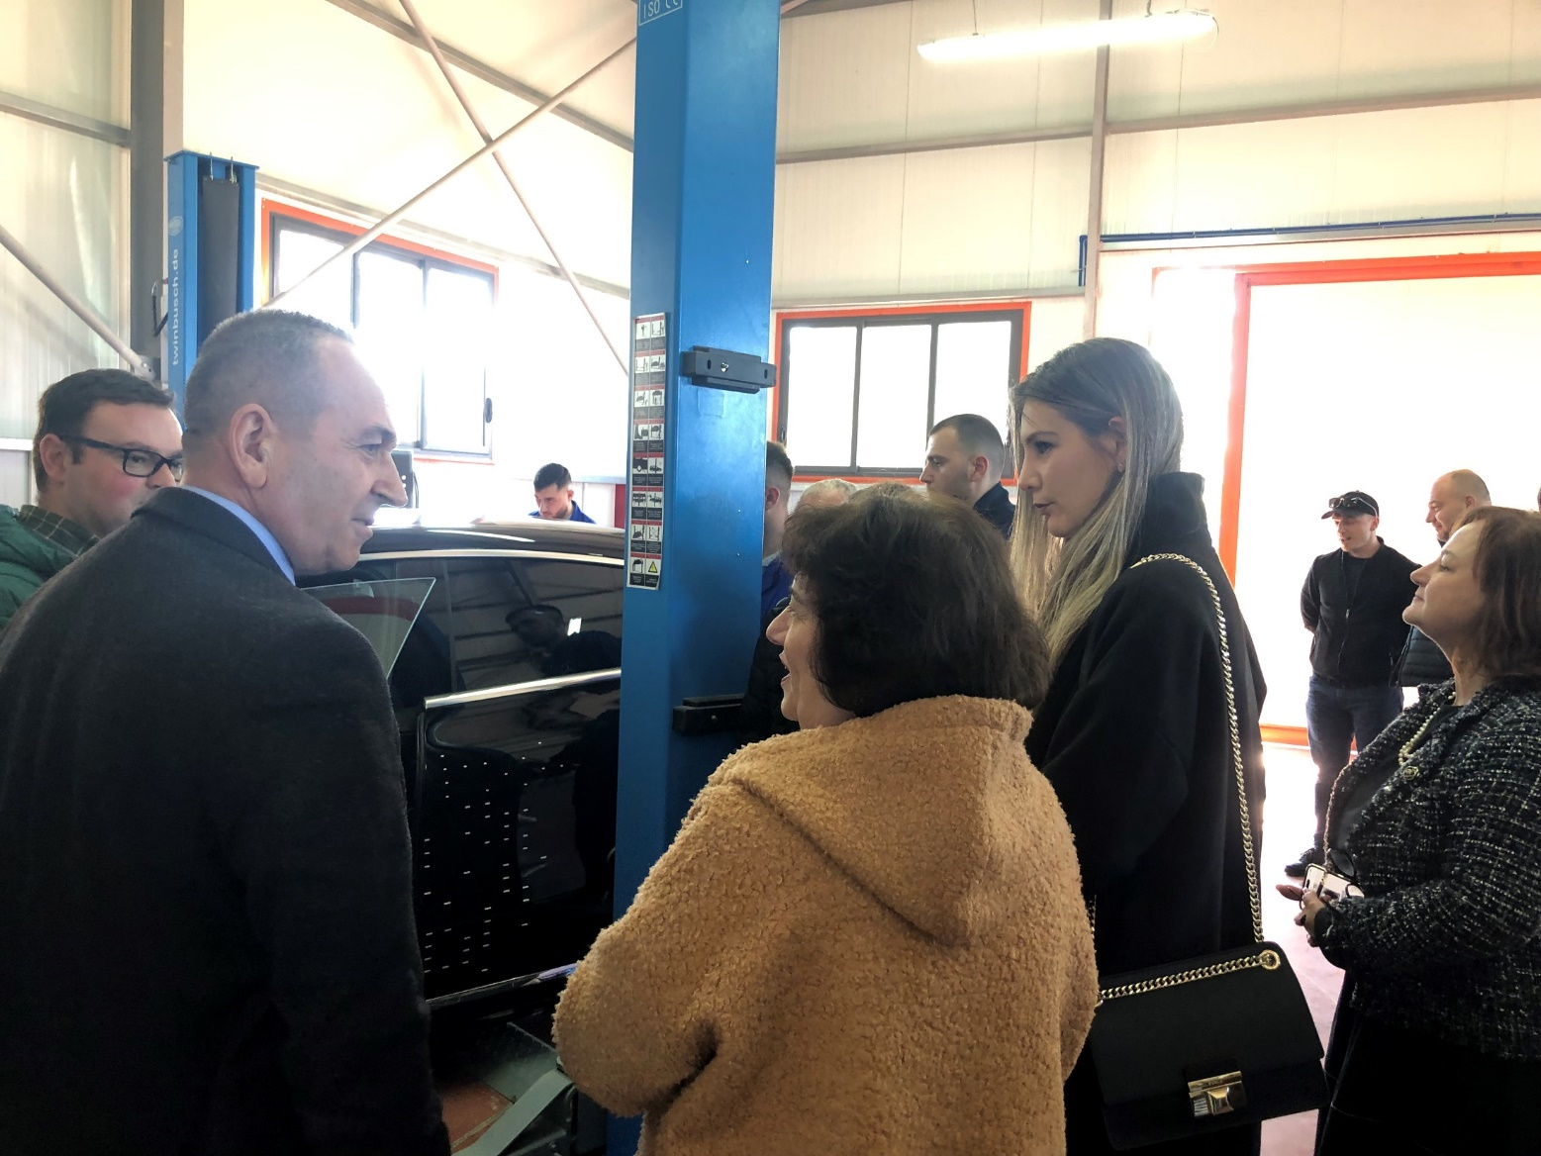
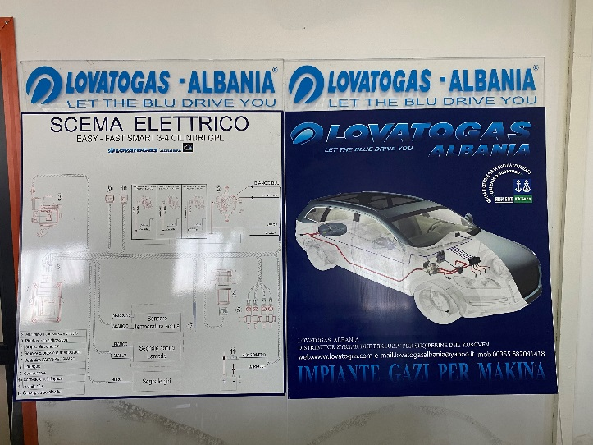

Slide 22
THANK YOU!

